Slide 1

SQL Programming Project Phase 1 & 2
Instructor: Mr. Hamid rajaee
Presented by: Peng wang

Slide 2
Questions to present (phase 2)
Q2 | Q3 | Q8 | Q9
Create a view to get all customers with total account balance (including interest rate) greater than 5000. | Create a view to get counts of checking and savings accounts by customer. | Create a stored procedure that returns error logs inserted in the last 24 hours. | Create a stored procedure that takes a deposit as a parameter and updates CurrentBalance value for that particular account.

Slide 3
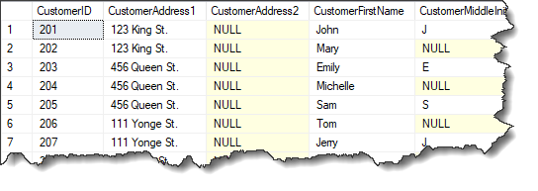
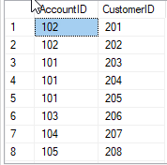
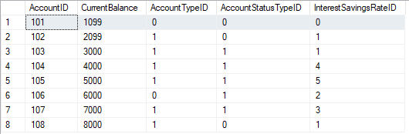
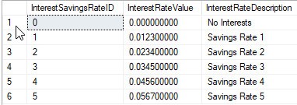
Q2:
Create a view to get all customers with total account balance (including interest rate) greater than 5000.

Slide 4
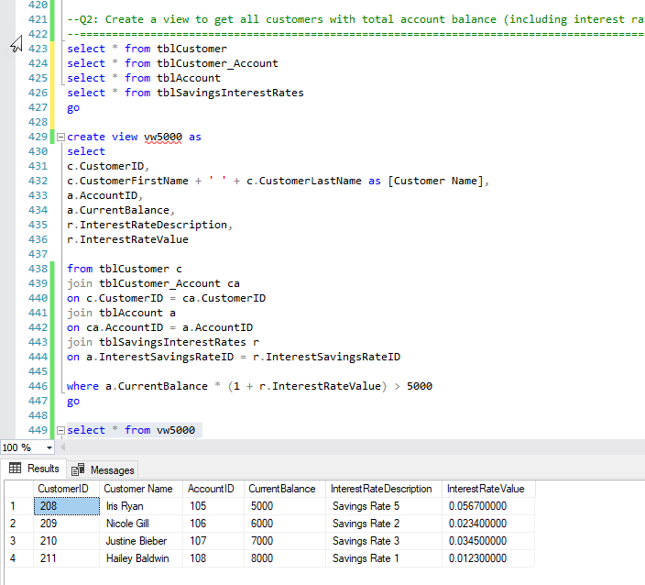
Q2 cont.
Create a view to get all customers with total account balance (including interest rate) greater than 5000.

Slide 5

Q3:
Create a view to get counts of checking and savings accounts by customer.

Slide 6
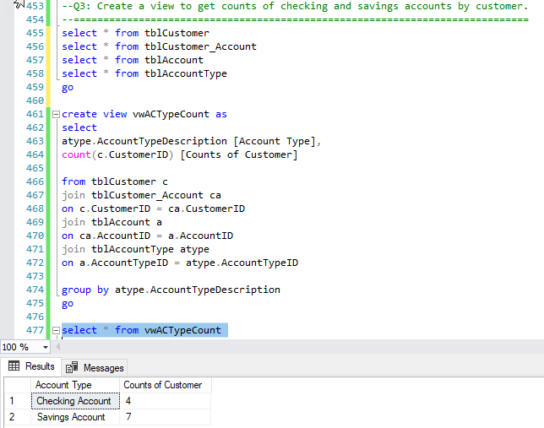
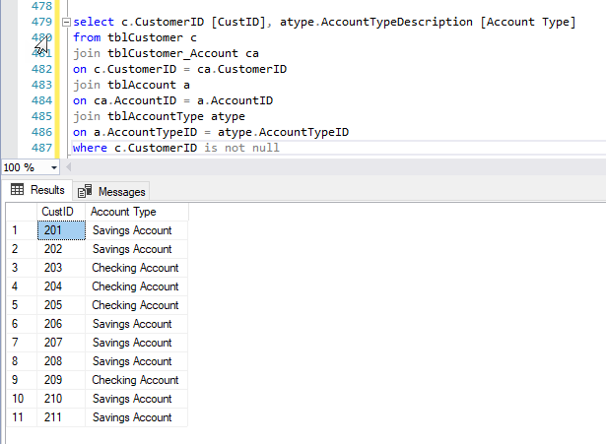
Q3 cont.
Create a view to get counts of checking and savings accounts by customer.

Slide 7
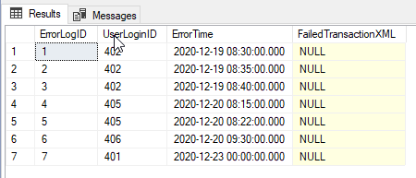
Q8:
select * from tblLoginErrorLog
Create a stored procedure that returns error logs inserted in the last 24 hours.
insert into tblLoginErrorLog values
(7, 401, convert(datetime, '2020-12-23 0:00', 120), null)

Slide 8
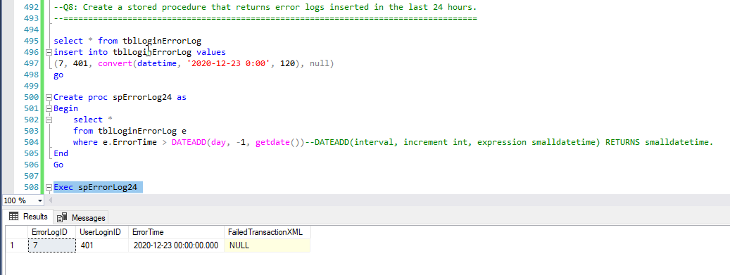
Q8 cont.
Create a stored procedure that returns error logs inserted in the last 24 hours.

Slide 9
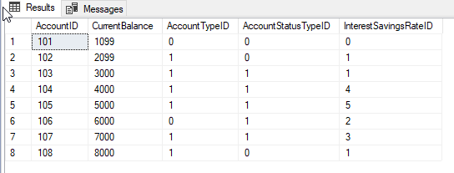
Q9:
select * from tblAccount
Create a stored procedure that takes a deposit as a parameter and updates CurrentBalance value for that particular account.

Slide 10
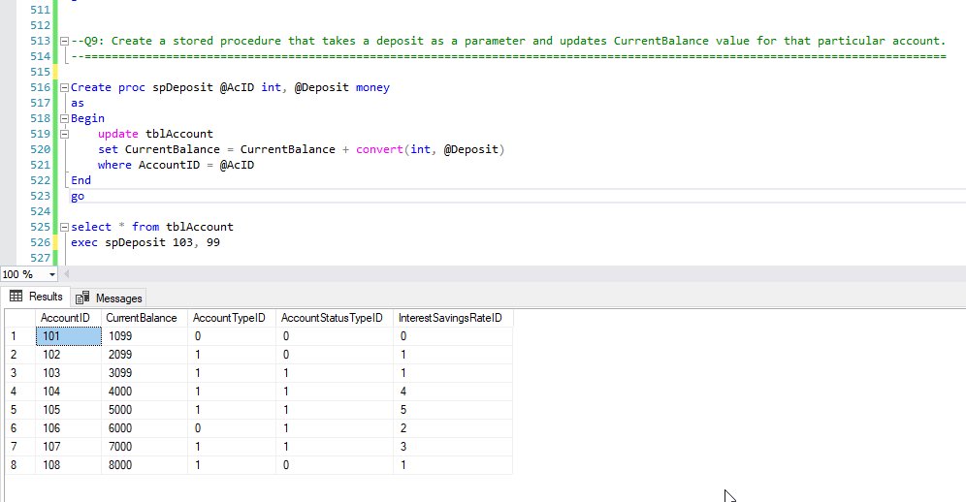
Q9 cont.
Create a stored procedure that takes a deposit as a parameter and updates CurrentBalance value for that particular account.

Slide 11

Questions & Suggestions

